Slide 1
Design of Customer Review Database in Tourism Website
Wenqing Shi
CIS 556 – Database System
Winter 2018
Notes:
Please make sure check all the format details
You still have flexibility to organize your slides, such as color pattern, background, font type and size, etc, but make sure includes all the necessary materials and follow the particular format for certain materials
You need a title page for your project presentation
Each group has about 20-30 min to complete the presentation, everyone needs to give about 5 min presentation as part of your group presentation.
Unless special case, such as DLN students, everyone needs to present and dresses properly, i.e., business casual attire. For male students, if you don’t have a suite, you can wear collared shirt

Slide 2
Which attraction deserve to visit when I only have 3-day holiday?
When is Michigan’s best travelling period?
Notes:
I like travelling, before I make my travelling plan. I always think of these questions Which attraction deserve to visit when I only have 3-day holiday in a New York? When is Michigan’s best travelling period? Is any attraction beautiful like the photos online? I always google these questions online.

Slide 3






Tourism Websites
Notes:
There are billions of information on tourism website. If someone can collect and analyze these data, It will be a win-win event for customers and tourism companies. That’s why I choose this topic.

Slide 4
Intentions
For visitors, it supports them to find where and when to an attraction.
For tourism websites, it supports them run specific advertisements on websites according to different users’ preferences.
For tourism companies, it supports them make more effective tourism products.
Notes:
I want to design a system that can complete these intentions. The system can be useful for visitors, tourism websites and companied.

Slide 5
TripAdvisor.com
The website link is (“Detroit” > “Top things to do”):
https://www.tripadvisor.com/Attractions-g42139-Activities-Detroit_Michigan.html
Notes:
I always use tripadvisor.com, so I choose this website to collect data. First, I need to grab the page’s link. then the web crawlers grab attractions in the page one by one. In each attraction, I need attraction’s and users’ review data.

Slide 6
Tools/Language
Python
PyCharm
MySQL
MySQL Workbench
Notes:
I am not an expert programmer. Python is more friendly for begaineer. So I use Python and MySQL to complete this project.

Slide 7
Design Process
Create my database by Python
7 entiries: Cities, Attractions, Users, Reviews, Nearby_hotels, Nearby_restaurants, Nearby_attractions
Write web crawlers to grab data in website by Python, grab more than 10,000 reviews in Detroit
Insert data into tables by Python
Use MySQL Workbench as a front end for database users
Notes:
MySQL workbench is easy use for database users, so I didn’t design front end. users can operate query/ select/ grant and other functions in it. It will cost 30 mins to complete collection.. During the code running, MySQL workbench can show the insert process at the real time.

Slide 8
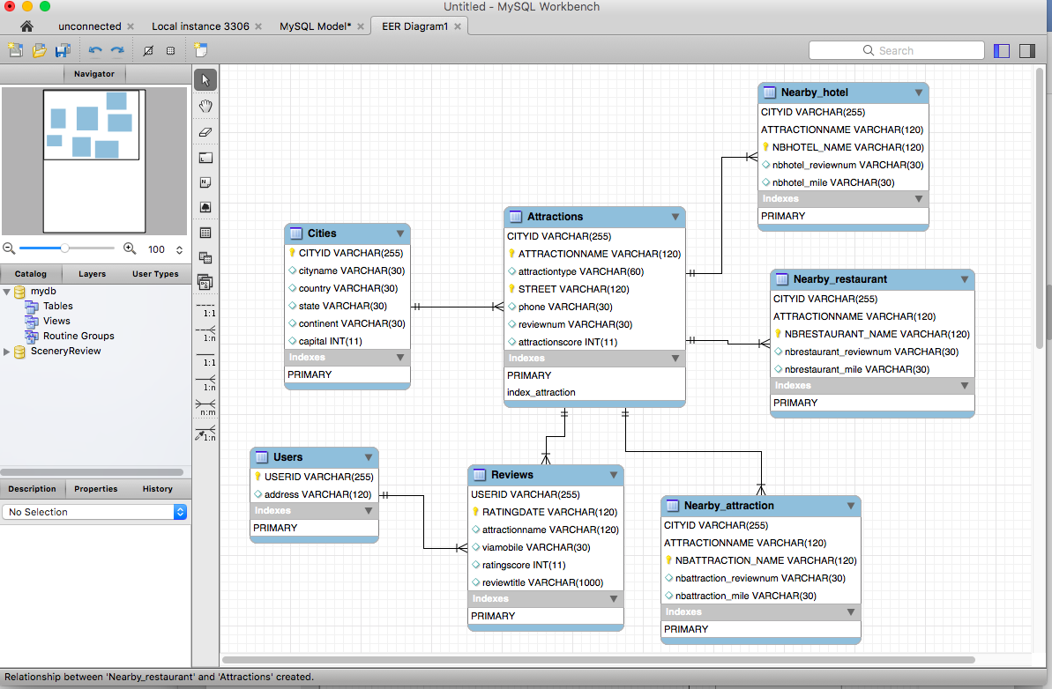
EER diagram
d
Notes:
This is the EER diagram of my system.

Slide 9
Limitations
The reviews have all kinds of formats, symbols, languages, typing habits. The data I grab is not so clean.
Every website has its own script, some data is so hard to grab. Some meaningful attributes are not include in my database.
Notes:
It needs much time in dealing with data.

Slide 10
Conclusions
I design the system, hope it can support visitors, tourism websites, tourism companies even governments to make sure which attractions to go, to advertise targeted customers, to make better tourism products and make scientific decisions.
Notes:
It needs much time in dealing with data.

Slide 11
Thanks!
Notes:
Make sure give audience time to ask question.

